Slide 1
Enhancing Focus on Customer Perception How Sentiment Analysis of Twitter posts on Covid-related keywords provide a metric for Delta’s continued focus on safety
TechOps Analysis & Performance
Erica Bonnette

Slide 2
Created a Dataframe using information obtained from a web scraper of twitter posts from the past two years: 2019- 2021
Separated information into different categories: Precovid (as a baseline) and Post Covid. In addition, created a separate dataframe including only content mentioning safety and inflight offerings.
Posts had to be addressed to or mentioning the account “@Delta”
- Overall sentiment scores were slightly up for the year of 2020 vs. the year of 2019, but there were particular keywords and days that showed more of a difference in sentiment than others.
- Safety had a negative change in posted sentiment using both Textblob and Vader Sentiment Analysis, whereas in flight offerings such as snacks and blankets increased in volatility after covid measures were put into action.
Sentiment fell along divided political party lines.
Increase cleaning crew time spent on aircraft in between flight changes.
Limit Delta’s political contributions to candidates or make financial disclosures less public.
Increase communication between flight attendants and gate agents to resolve seating issues before the flight takes off
Stay the course on mask enforcement and regulation.

Slide 3
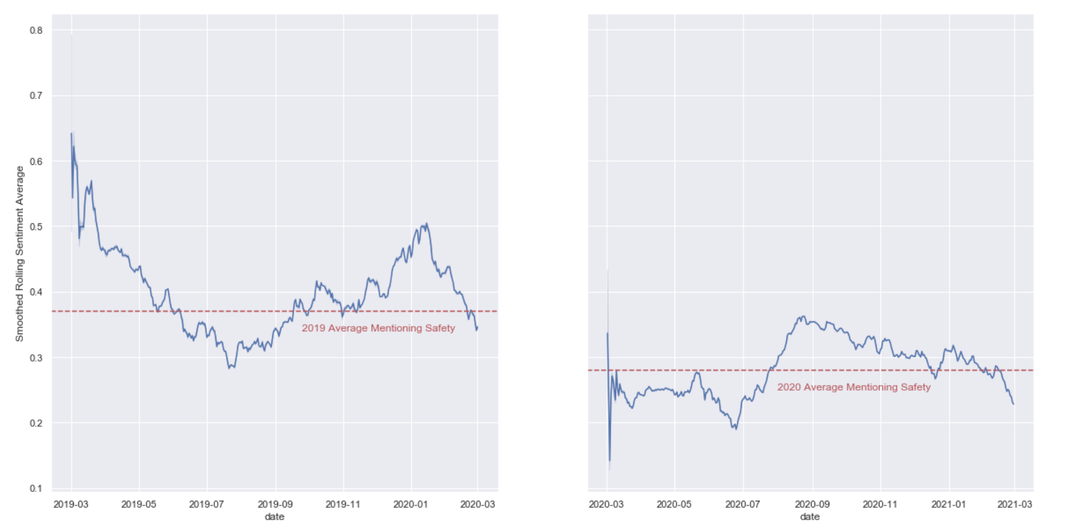
Overall Sentiment Scores
Scores Increased Generally
Delta Overall Sentiment Score 2019:
0.135
Delta Overall Sentiment Score 2020:
0.171
But when it comes to Isolating the topic of Safety:

Slide 4
Safety Tweet Examples:
Tweets Regarding Seat Issues
“In the middle of covid Delta is not cleaning the seats, or following any safety protocols for their passengers, this flight LA-New Orleans, business class, and that kleenex was there from the previous flight!!! 😡”
“I’m on a Delta flight and two men seated in my row are blatantly disregarding the mask rule, playing on their phones without any sort of face covering. Flight attendants have yet to approach them reminding them of the rule. I feel unsafe.”
“Delta books a stranger in the seat next to me on a flight, I discovered this after boarding, and the answer by the flight attendant was, this is a fully booked flight... Very unhappy with Delta in these days of rising cases.”
“Hey Delta! Little confused as to why I’m sitting next to someone on my flight when you guys tout having seats blocked? And say to keep a safe distance?”

Slide 5
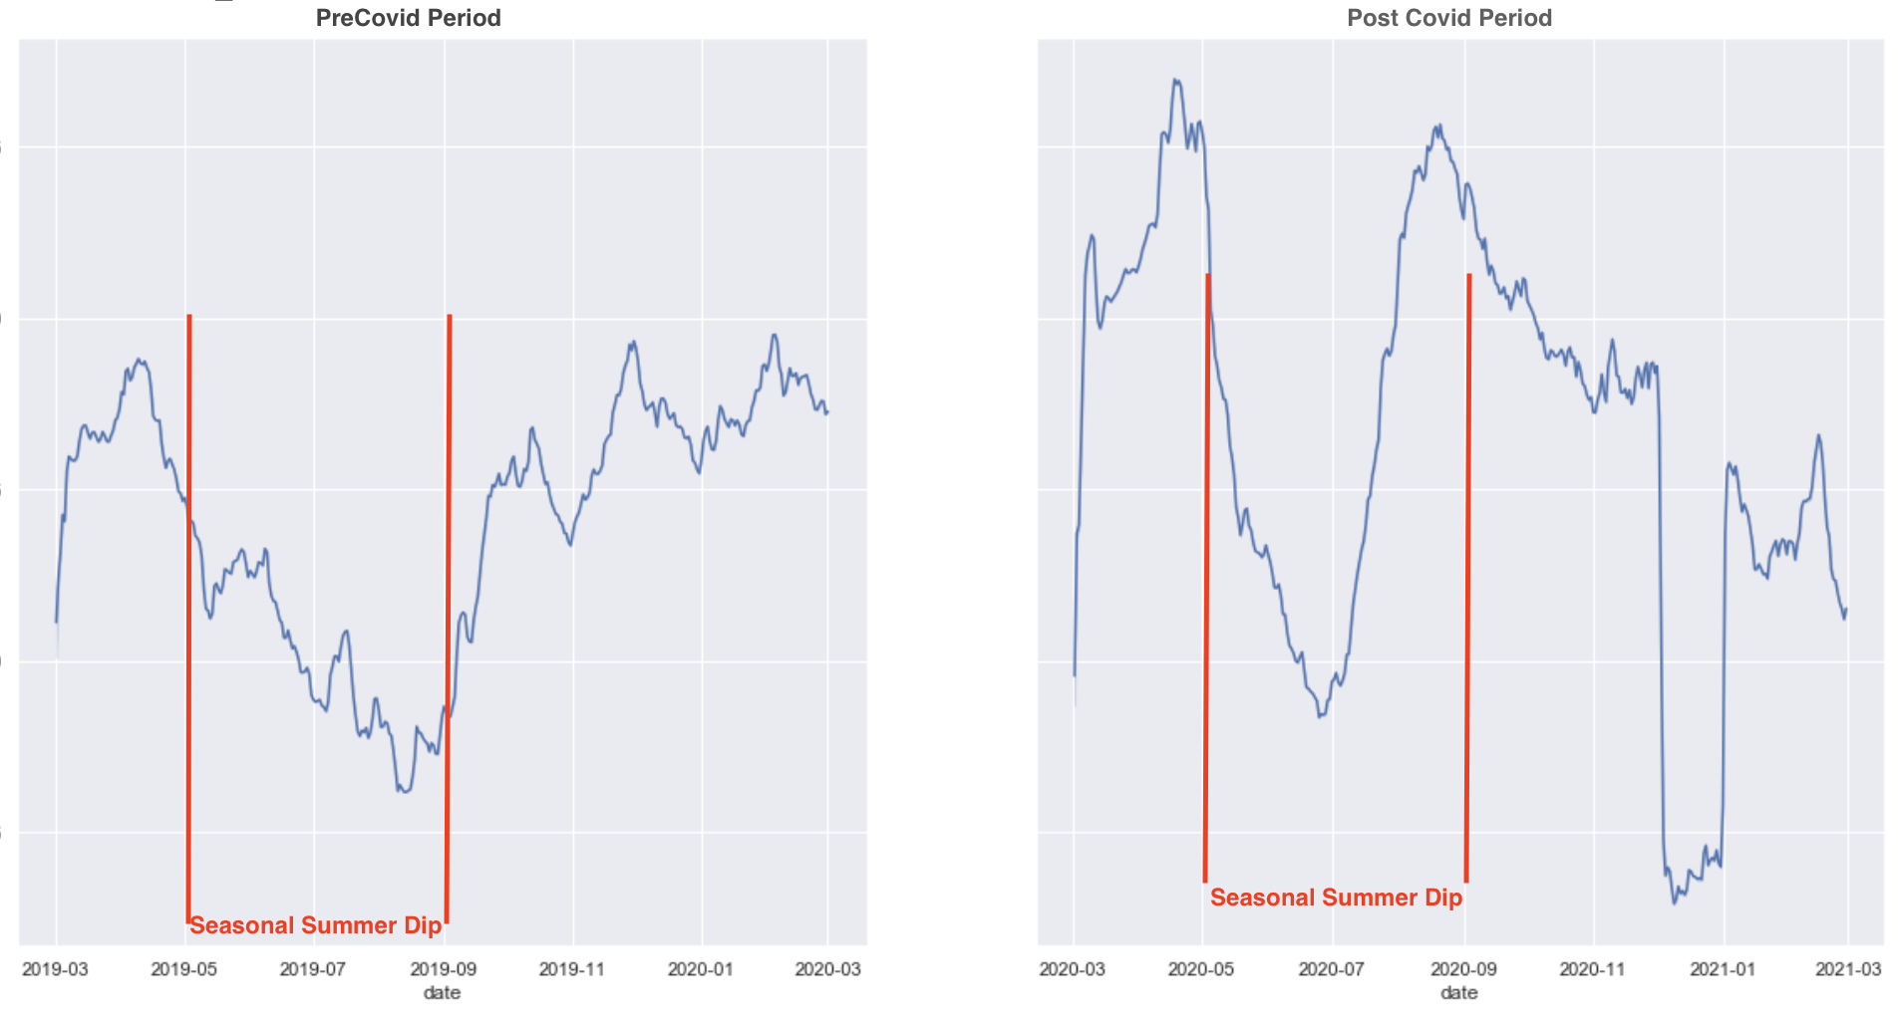
Seasonal Dips in Summer
As you can see, there is still a very large dip in December 2020 that does not account for the seasonality.

Slide 6
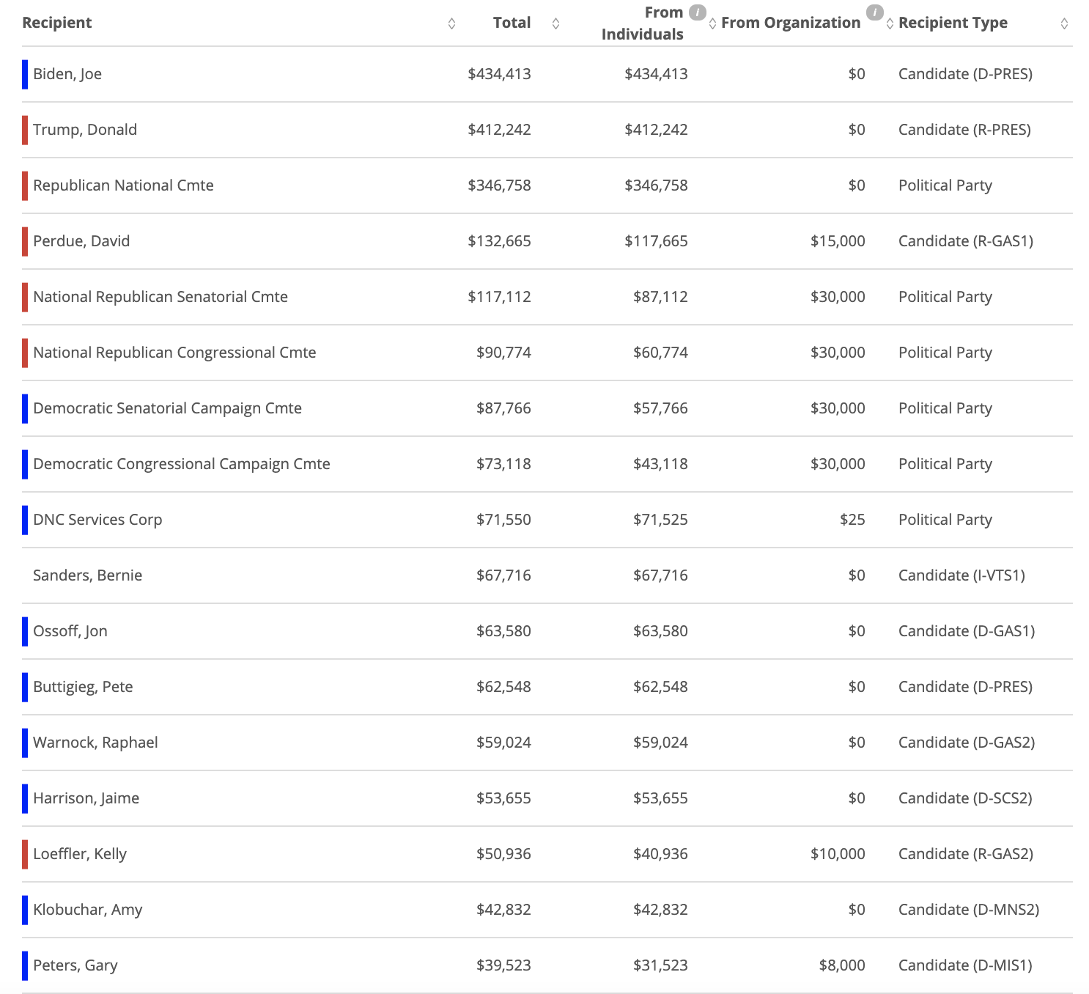
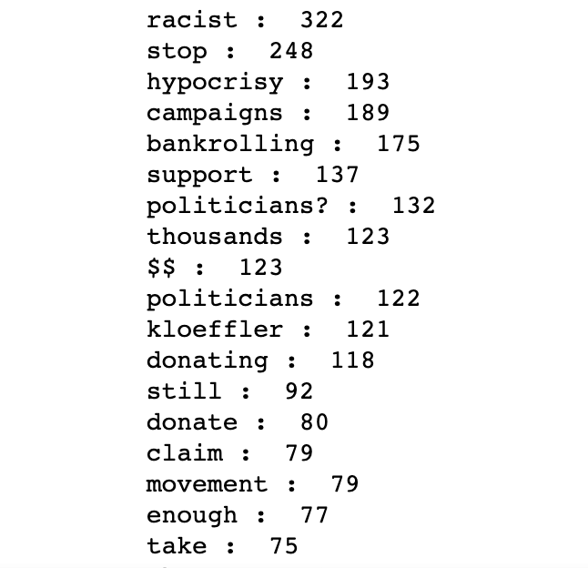
Describing the December Dip
Chart showing Delta political contributions that was leaked on twitter from opensecrets.org
Word Counts of tweets with negative Sentiment Score on December 12, 2020 :

Slide 7
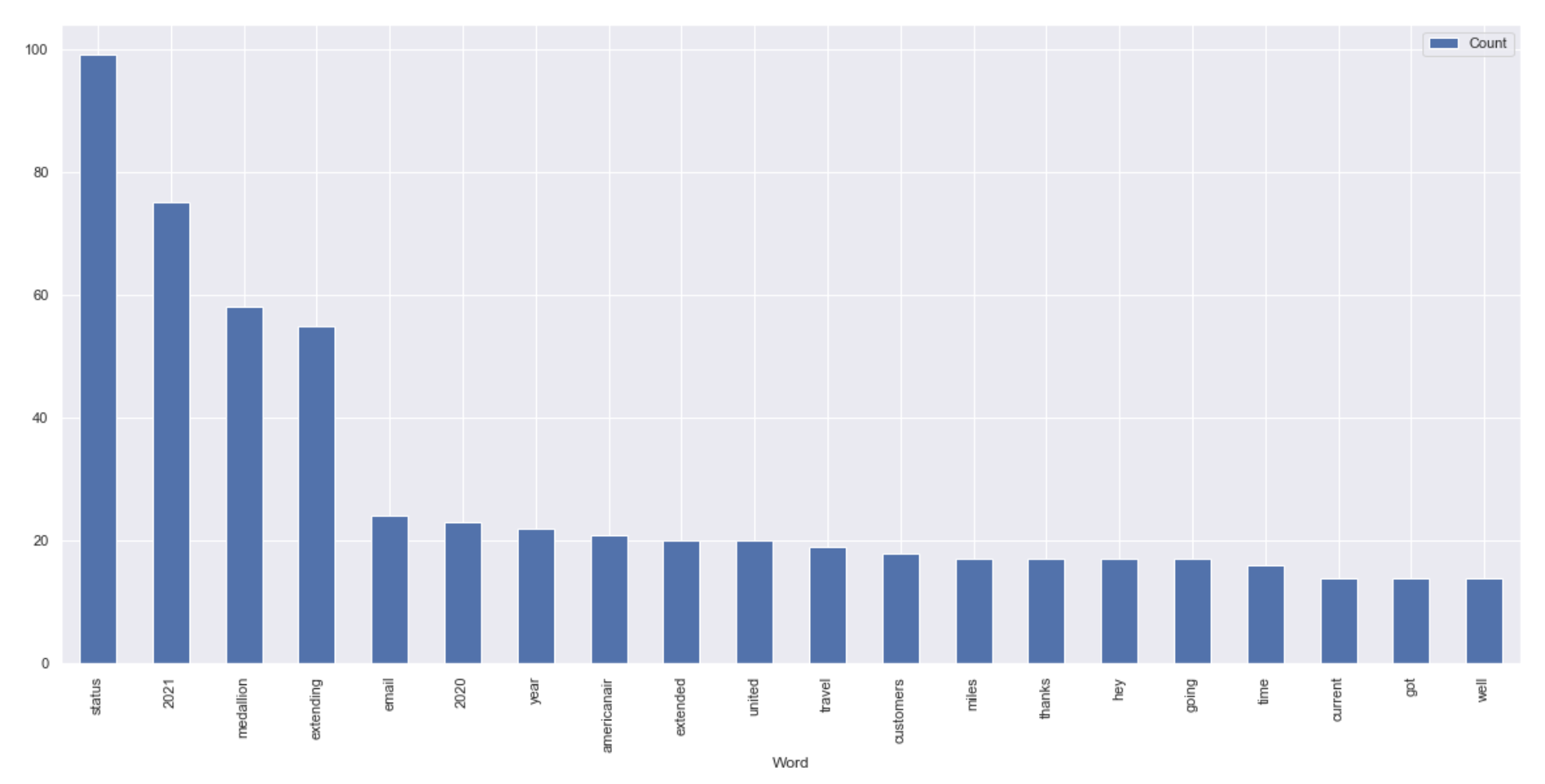
Delta Best Day
Tweets Regarding Medallion Status

Slide 8
Conclusion
Main Takeaways
There are three main takeaways from this analysis that can be done to increase sentiment scores in the future. The first and most pressing given the amount of negative tweets was due to the financial endorsement of a political figure. Given the polarization of politics today, Delta would do best to avoid all associations with politicians online and in general to prevent itself from alienating a portion of its client base supporting an opposing politician. The second is to figure out a process for dealing with seating issues more efficiently. An easy fix to the primary seat cleanliness issue is to increase cleaning time or cleaning crew power in between flights to make sure the planes are as spotless as can be. In addition, because another concern from tweets regarding safety in a negative rating had to do with seating issues, creating a process in between flight attendants and gate agents to minimize middle-seat exceptions before the plane takes off will help as well. Mask polarization was very high when it came to positive and negative sentiment but overall those in favor of mask wearing and enforcement gave delta a higher sentiment score, so staying the course and keeping up with the safety emphasis and mask compliance by employees is the right way to go.

